Slide 1
ONLINE MARKING TRAINING
By
Jerusha Kimani

Slide 2
Learning Outcome
At the end of this training you should be able to;
Login to eclass.uonbi.ac.ke
Locate and Open your courses
Mark online
Download Marks

Slide 3
How to Login
Use your Active Directory (AD) Account
Username: Payrollno/IDno
Password: AD password
Link: https://eclass.uonbi.ac.ke

Slide 4
How to Locate and Open Courses
Go to my courses and click on the course you want to mark the exam
Click on the exam you want to mark

Slide 5
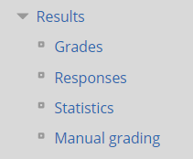
Opening the Questions to be marked
On your right go to administration block, click on results to expand it and then click on Manual grading link.

Slide 6
How to Mark Online
Use the column “To grade” and click on the links provided to mark the questions.
NB: The system allows one to mark a question at a time.

Slide 7
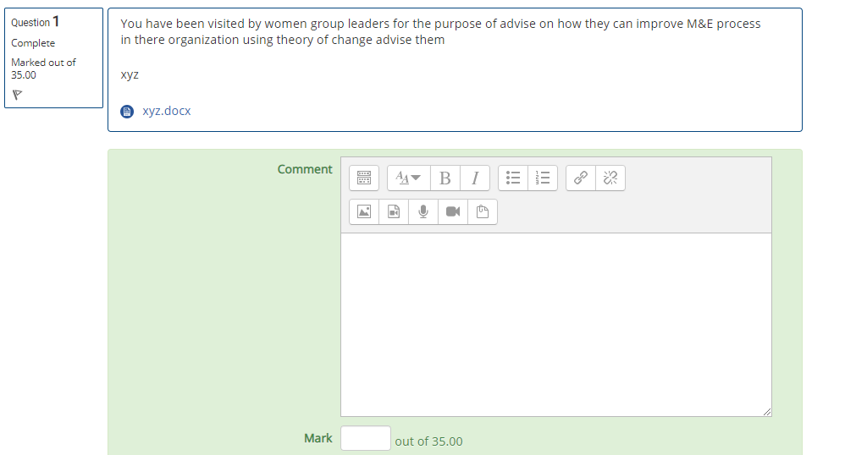
How to Mark Online
Question
Answer
Put your comments here
Award marks here

Slide 8
Updating Marks
Use the column already graded to edit marks

Slide 9
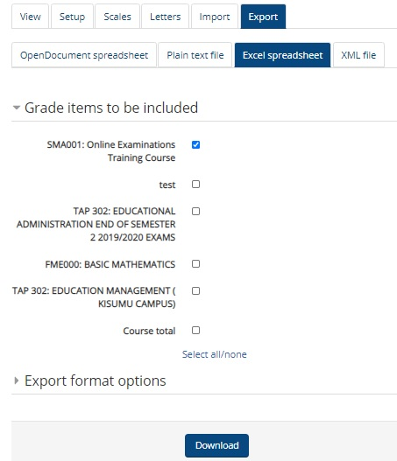
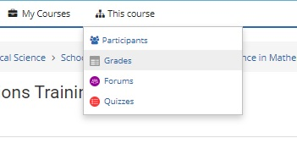
Download Mark sheet
Go to this course ( next to my courses)
Click grades, export, excel spreadsheet,
ensure only the relevant exam is checked, save

Slide 10
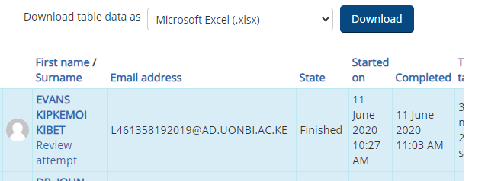
Download responses
Scroll down and above the locate “Download table data as” select Microsoft Excel and click Download button.

Slide 11
Question and Answer
END

