Slide 1
TOPIC 2
Types of MARINE ECOSYSTEMS

Slide 2
Objectives
At the end of this topic you should be able to
Describe different marine ecosystems
Outline the characteristics of each of the marine ecosystem
Discuss factors that threaten marine ecosystems

Slide 3
What is marine microbiology
As usually defined microbiology encompasses the study of bacteria, viruses and fungi although the study of each of these groups is a specialized field (bacteriology, virology, mycology, phycology).
In this course unit we are going to study:
The interaction between marine microbes and interaction with the environment (Biotic and Abiotic components of the ecosystem)
How we can access microbial biomass from marine ecosystems(research methods)
How we can harness ocean microbial resources for human benefit(biotechnology)

Slide 4
Importance of microbes in the living world
The most important feature of microbes are their exceptional diversity and ability to occupy every conceivable habitat for life.
Microbes have been isolated from habitats previously thought as inhospitable to them.

Slide 5
They play a role in
Transformation processes of elements (biogeochemical processes /cycling of elements
Degradation of organic matter
Regulation of population of animals (causing diseases
Primary production (source of food)
They are found in the intestinal tracts of many animals helping in digestion and producing vitamins.
They also degrade all kinds of compounds hence help in degradation of pollutants (oil).

Slide 6
Food spoilage
Destroy objects by biodeterioration, biofouling.
In biotechnology- Human health (antibiotics, anti-viral compounds, anti-tumor compounds, enzymes etc. Environmental biotechnology; Aquaculture and food industry
Blue economy
“What is the Blue Economy?”.......international conference held at UoN in 2018........Find out what it was all about

Slide 8
Types of marine ecosystems
What is an ecosystem = organisms + physical environment in which they interact + processes(nutrient cycles and energy flow)
Marine ecosystems are a part of the largest aquatic system on the planet, covering over 71% ( ⅔) of the Earth's surface.
The habitats that make up this vast system are many.
Range from the productive near shore regions to the barren ocean floor.

Slide 9
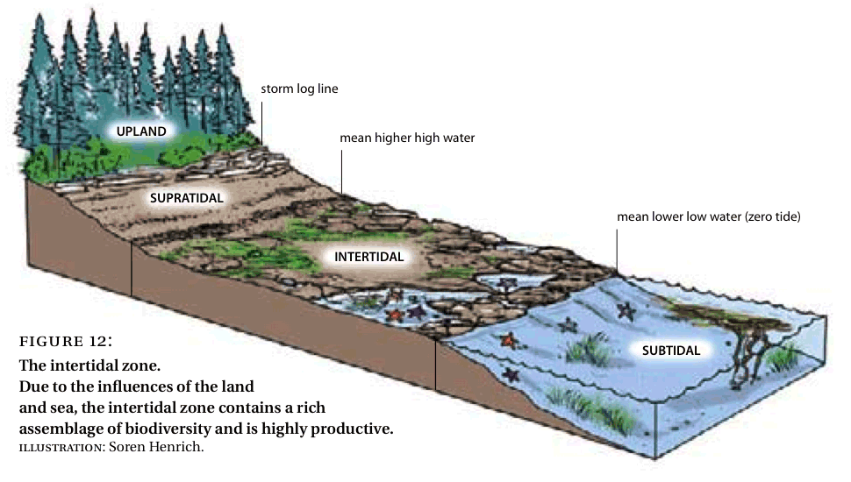

Slide 10
The marine ecosystems is made up several ecosystems, namely:
Oceans
Estuaries
Salt Marshes
Coral reefs
Mangrove Forests
Lagoons,
Kelp forests ,Sea grass beds
Intertidal systems: (rocky, sandy, and muddy shores)

Slide 11
1. Open Ocean
Open ocean make up the largest marine ecosystems, but ironically, they shelter the fewest species per volume in that area.
Open ocean water lies above the continental shelf and can reach from 200 to 11,500 m.
Open ocean areas are great producers of phytoplankton, which makes its own food through photosynthesis.

Slide 12
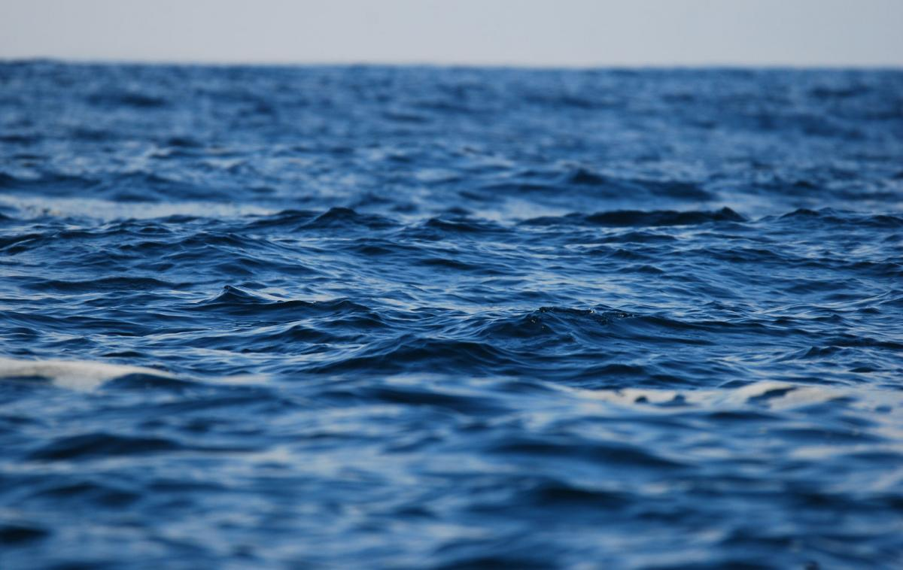

Slide 13
Wang’ondu

Slide 14
2. Sea grass beds
Located in the intertidal zone (photic zone)0-200m
The are flowering plants (angiosperms) belonging to four families which grow in marine, fully saline environments.
Wang’ondu

Slide 15
Sea grass beds
Wang’ondu
Wang’ondu

Slide 16
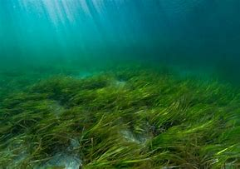

Slide 17
3. Coastal Lagoon
They are shallow, often elongated bodies of water separated from the larger body of water by a shallow or exposed coral reef, or similar feature.

Slide 18
4. Estuary
Is a partially enclosed coastal body of brackish water(has more salinity than fresh water, but not as much as seawater) with one or more rivers or streams flowing into it, and with a free connection to the open sea.
Tide meets the stream (salty water mixes with the fresh water
They are highly productive ecosystems, with high biodiversity. Why?

Slide 19
River Sabaki Estuary (Kilifi county)
Wang’ondu

Slide 20
They are also loaded with nutrients and sediments carried from upstream (agricultural soils/fertilizers/chemicals)
Many species use estuaries as nurseries, raising their young there until they are old enough to travel into the open ocean.
Estuaries play an important part in filtering and cleaning waters of pollutants because they are highly populated with plants and animals that can ingest high amounts of toxins.

Slide 21
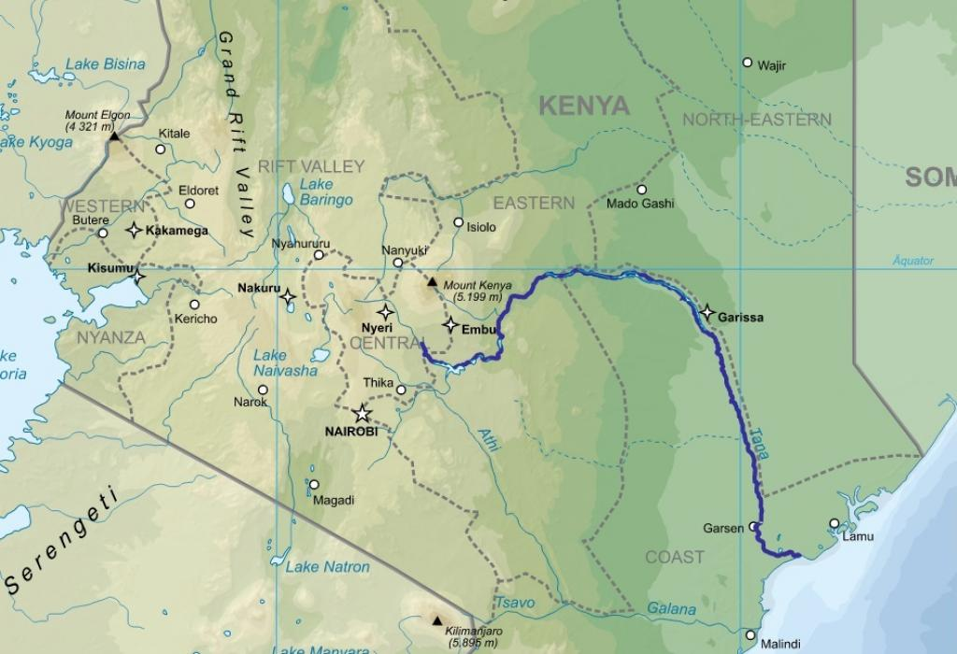

Slide 22
5. Salt marshes
A salt marsh also known as a coastal salt marsh or a tidal marsh, is a coastal ecosystem in the upper coastal intertidal zone between land and open salt water or brackish water that is regularly flooded by the tides.
It is dominated by dense stands of salt-tolerant plants such as herbs, grasses, or low shrubs.
Mostly found in temperate regions.

Slide 24
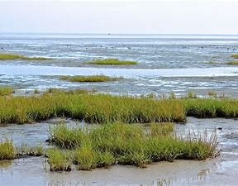

Slide 25
6. Muddy shores
Common along the sheltered beaches, estuaries and mangrove forests.
The mud is also known for its high organic carbon content and hence serves as a very good food source for many of the mud dwelling organisms.

Slide 26
Muddy shores

Slide 27
7. Sandy shores
They have drier upper shore and wetter lower shore than muddy ones.
Demonstrate a zonation of organisms which can only be seen by digging up the species.
surface of the upper shore dries at low tide (drainage through sand)
substrate is relatively unstable compared with rocky shores
no substrate for attachment (burrowing)
no shelter and so animals have to burrow to remain on the shore
no seaweeds

Slide 29
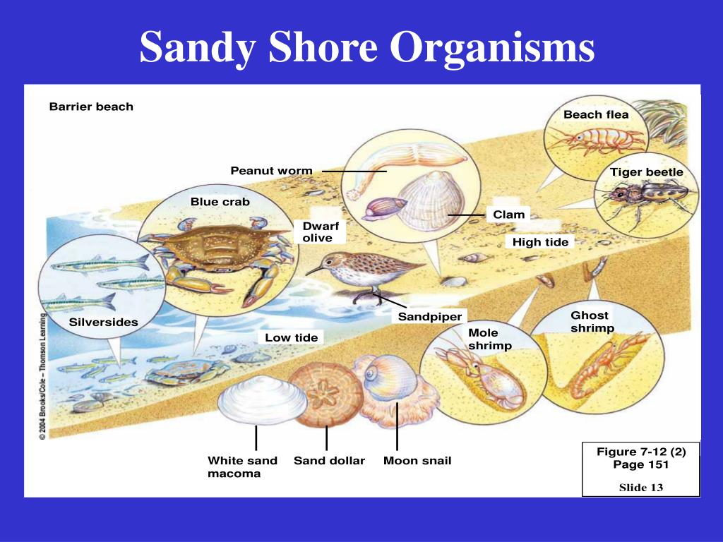

Slide 30
8. Rocky shores
An intertidal area of seacoasts where solid rock predominates.
They are biologically rich environments, and are a useful "natural laboratory" for studying intertidal ecology and other biological processes.
They have been well studied (accessibility) for a long time and their species are well known.

Slide 32
There is vertical zonation in rocky shore communities
Species closer to the high tide mark are well adapted to air and sunlight exposure without drying
Species closer to (and below) the low tide mark are adapted can cope with long periods of being submersed in water.
These physical and ecological pressures lead to distinct zones in the community of invertebrates that live on rocky shores.
Common rocky shore groups include mussels, barnacles, sea anemones and predatory sea stars,

Slide 33
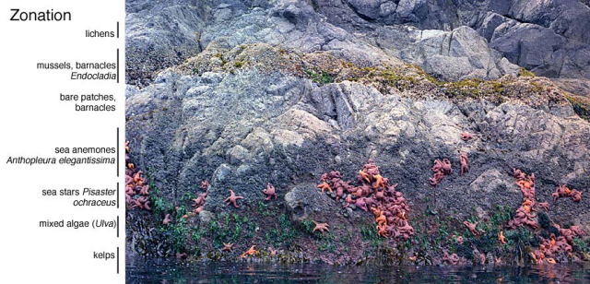

Slide 34
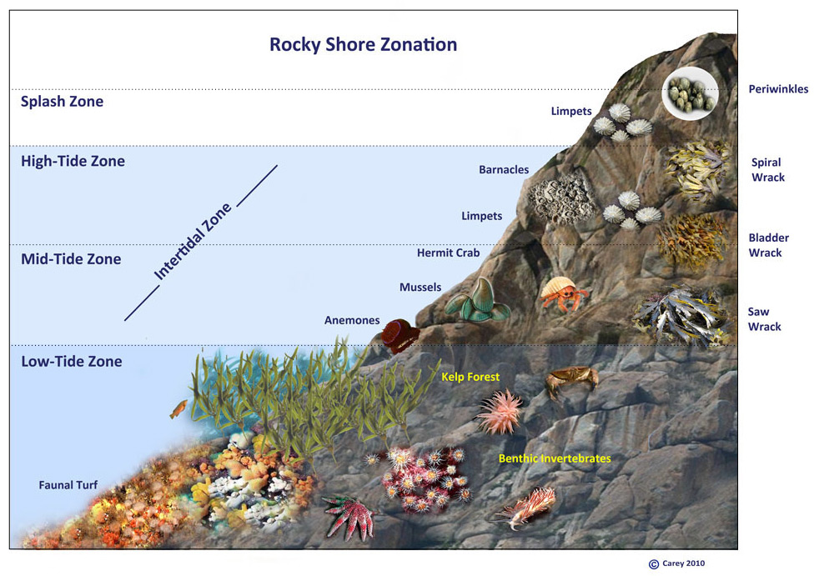

Slide 35
9. Mangroves
Are shrubs or trees (salt tolerant-halophytes) that grow in coastal saline or brackish water.
They have aerial breathing roots (prop roots or pneumatophores
Important carbon sinks-climate change mitigation
Mikoko pamoja project(kwale county)
Questions
a)Why are mangrove ecosystems important?
b)How many species do we have in Kenya?

Slide 38
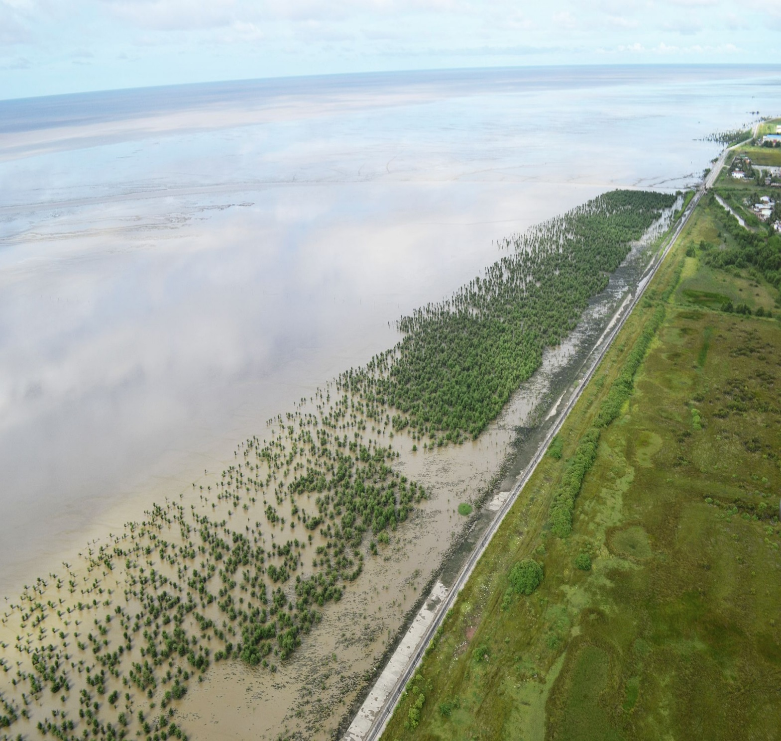

Slide 39
Mangrove forest board walk for ecotourism

Slide 41
10. Coral reefs
Coral reefs are diverse underwater ecosystems (rocky structures) held together by calcium carbonate.
A habitat to many species of fish and microbes
Coral reefs occur in areas that are shallow or clear enough that sunlight can reach corals, generally tropical areas.

Slide 42
They are extremely fragile in nature, they also represent some of the most biodiverse ecosystems in the world.
Coral reefs make up just 0.02% of the ocean but shelter ⅓ of the marine life on the planet

Slide 43
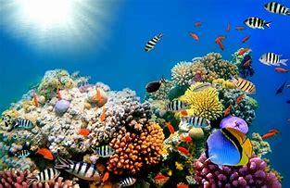
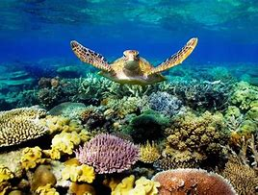
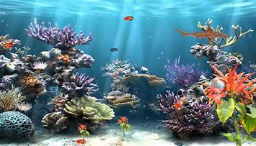
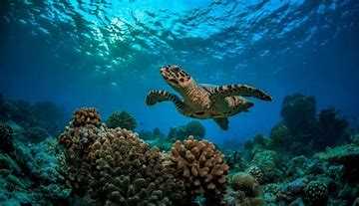

Slide 45
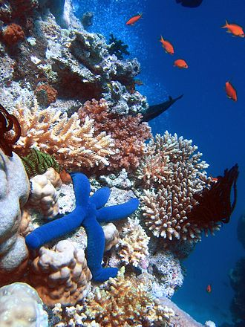

Slide 46
Great Barrier Reef (Australia)

Slide 47
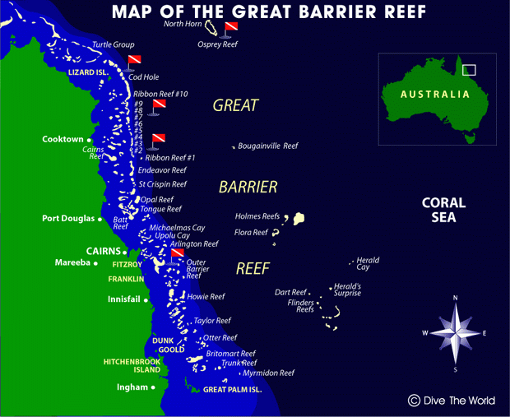

Slide 48
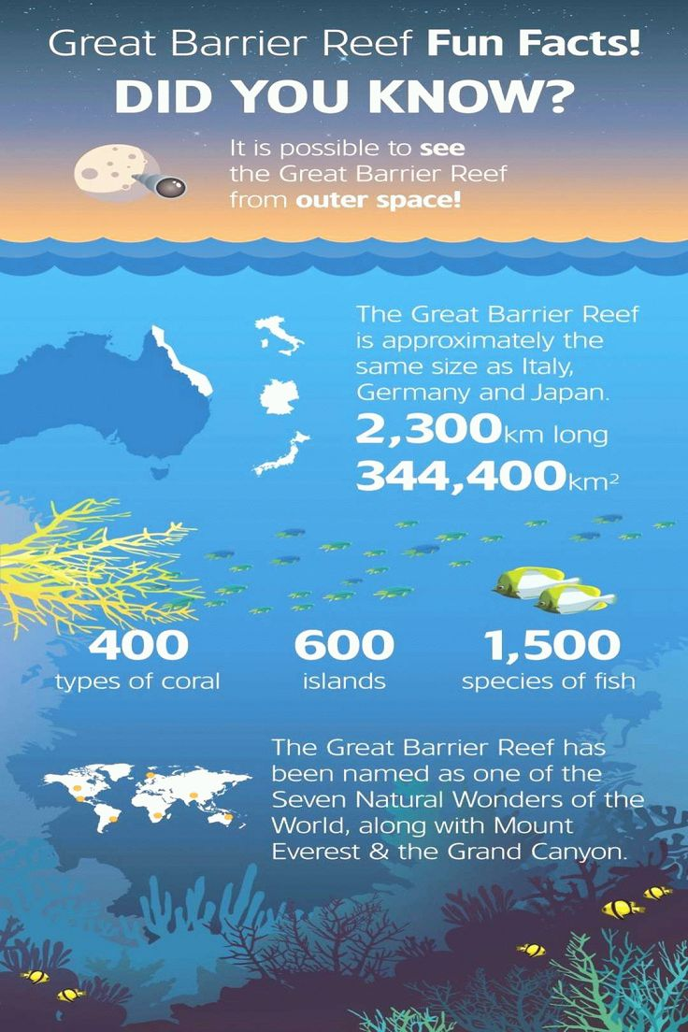

Slide 49
Unique qualities of marine ecosystems
Marine ecosystems contain several unique qualities that set them apart from other aquatic ecosystems.
The key factors being:
1. The presence of dissolved compounds in seawater, particularly salts.
This total gram weight of dissolved substances (salts) in one kg of seawater is referred to as salinity.

Slide 50
In general 85% of the dissolved substances are Sodium (Na) and Chlorine (Cl) in seawater.
On average seawater has a salinity of 35 parts per thousand (ppt) grams of water(). 35‰
What is the role of the dissolved compounds?
Give seawater its distinctive "salty" taste
Affect species composition of particular marine habitats,
Prevent oceans from freezing during winter (-2- 6°C).

Slide 51
2. Limiting factors (nutrients and light)
Like other aquatic ecosystems, marine ecosystems require nutrients and light to produce food and energy.
However, both nutrients and light are limiting factors in marine ecosystem productivity. (Oligotrophic)
Nitrogen (N), Phosphorus (P), and Silicon (Si) are essential for food generation to promote growth and reproduction.
Nutrient availability often varies significantly from place to place.

Slide 52
For example, in the open ocean, nutrient levels are often very poor causing primary production to be very low.
In contrast, near shore waters such as estuaries and marshes are often rich in nutrients due to runoff and other terrestrial sources.
Excess nutrients can cause an over-stimulation of primary production, depleting oxygen levels and causing eutrophic conditions to occur in coastal habitats.

Slide 53
Light is important for primary production in the ocean.
Like many other aquatic plants, photosynthetic marine organisms (i.e., phytoplankton) rely upon chlorophyll a to absorb visible light from the sun.
The amount of light penetrating the ocean surface tends to decrease with increasing water depth.
Therefore photosynthesis can only take place within a small band near the surface of the water (called the photic zone).

Slide 55
3. Global role
Marine ecosystems are very important in the overall health of both marine and terrestrial environments.
According to the World Resources Center, coastal habitats alone account for approximately 1/3 of all marine biological productivity.
Estuarine ecosystems (i.e., salt marshes, sea grasses, mangrove forests) are among the most productive regions on the planet.
Mangrove ecosystems are also some of the active carbon sinks globally.
50% of the oxygen in terrestrial ecosystem comes from the ocean
They also contribute KSh 160 billion annually in fisheries worldwide

Slide 56
In addition, other marine ecosystems such as coral reefs, provide food and shelter to the highest levels of marine diversity in the world.
The diversity and productivity of marine ecosystems are also important to human survival and well-being.
These habitats provide us with:
a rich source of food and income,
support species that serve as animal feed, fertilizers for crops, additives in foods (i.e., ice-cream) and cosmetics (i.e., creams and lotions)
Tourism
More than 600 million people (around 10% of the world’s population) live in coastal areas that are less than 10 meters above sea level.;
2.4 B (40% of worlds population) live within 100km from the coast

Slide 57
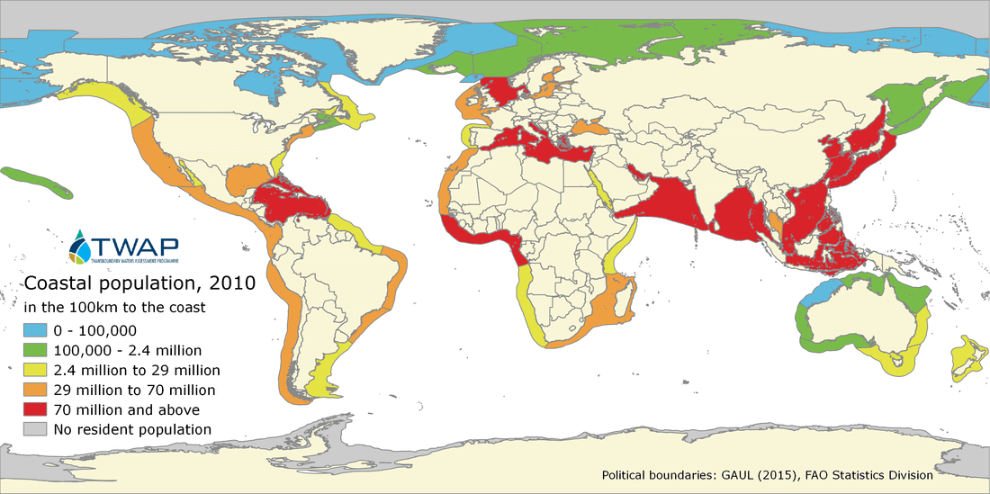

Slide 58
Questions
1. Discuss threats to marine ecosystem?
2. What are the threats to coral reef ecosystems?

