Slide 1
EXTERNAL EXAMINER MANUAL
By
Jerusha Kimani
Edited by
Charles L. Omondi

Slide 2
Training learning Outcome
At the end of this training you should be able to;
Login to eclass.uonbi.ac.ke
Locate and Open your courses
Open Exam
Download marks
View or Edit Marked Scripts
Documenting Changes made

Slide 3
Step 1: Login
Use the Login credentials provided
Username: Payrollno/IDno
Password: AD password
Link: https://eclass.uonbi.ac.ke

Slide 4
1.Select the course
How to step 2: Locate and Open Courses
Login
Click my courses and select the course
turn on the editing

Slide 5
Step 3: open Exam
Click on the name of exam to open it (a link with red icon to the left)

Slide 6
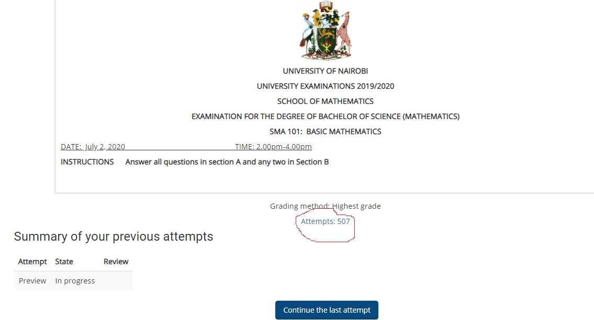
Step 5: Viewing score summary
Click attempts link on the cover page

Slide 7
Step 6: Scroll down and click show data – below chart data

Slide 8
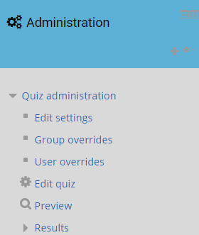
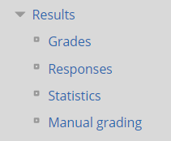
Step 7: Opening marked Questions
On your right go to administration block, click on Manual grading link.

Slide 9
Step 8: Viewing/Editing Marked Scripts
Use the column already graded to edit marks
Click on the link “Also show questions that have been graded automatically” to view questions marked by the system automatically.
NB: The system allows one to mark a question at a time.

Slide 10
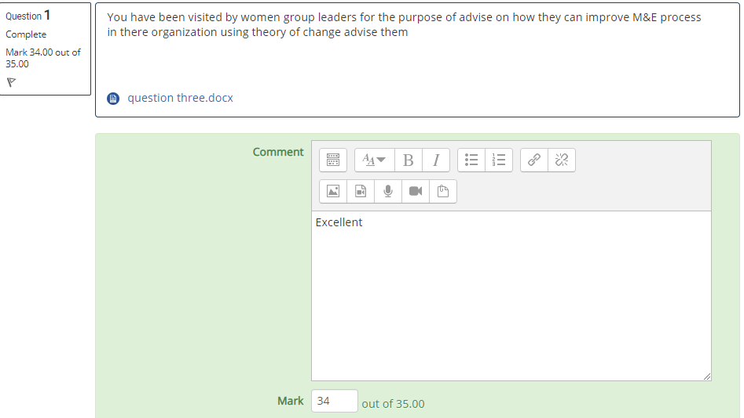
Step 8: Viewing/Editing Marked Scripts
Question
Answer
Add your comments here
Marks awarded

Slide 11
Step 9: Download responses
On your right go to administration block, click on results to expand it and then click on” responses” link.

Slide 12
Step 9: Download Marks
On your right go to administration block, click on results to expand it and then click on” Grades” link.

Slide 13
Step 10: view performance statistics
On your right go to administration block, click on results to expand it and then click on” statistics” link.

Slide 14
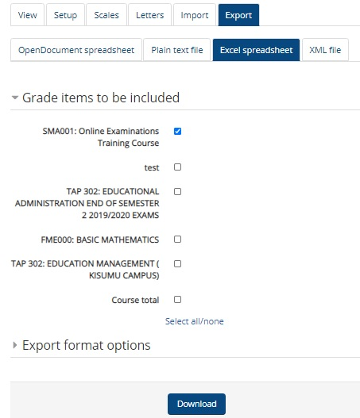
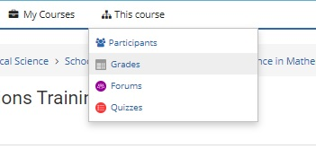
Step 11: Download Mark sheet
Go to this course ( next to my courses)
Click grades, export, excel spreadsheet,
ensure only the relevant exam is checked, save

Slide 15
Documenting Changes made
Method ONE
Open the downloaded document to Highlight any change you make on the marked script.
Method TWO
Open a word document and record the changes you have made per Question

Slide 16
Thank You
END

